Slide 1
Rural Stakeholders
Brenna Toquam, MSN, RN
6/5/2024

Slide 2
Get 1:1 Support
Delfina Doulas
Delfina Medical Group: Registered Dietitians, Mental Health Therapists, Lactation Support
Public health nurses

Slide 3
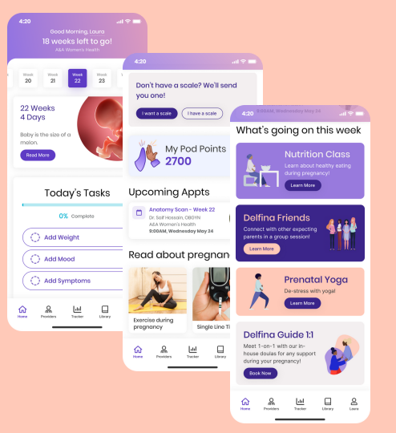
Track your pregnancy

Slide 4
Easily use Delfina on your phone!

Slide 5
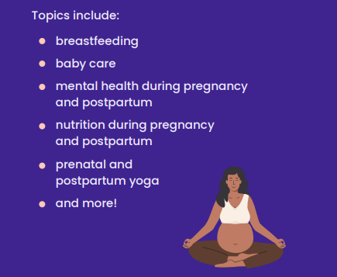
Join Delfina’s group classes!

Slide 6
How do I enroll?
Free to all South County pregnant and up to 1 year post-partum members.
Download the app and create a log in
Please Call member services at 1-866-567-7242 to get connected or contact your local public health department!

Slide 7
Questions?

